Slide 1
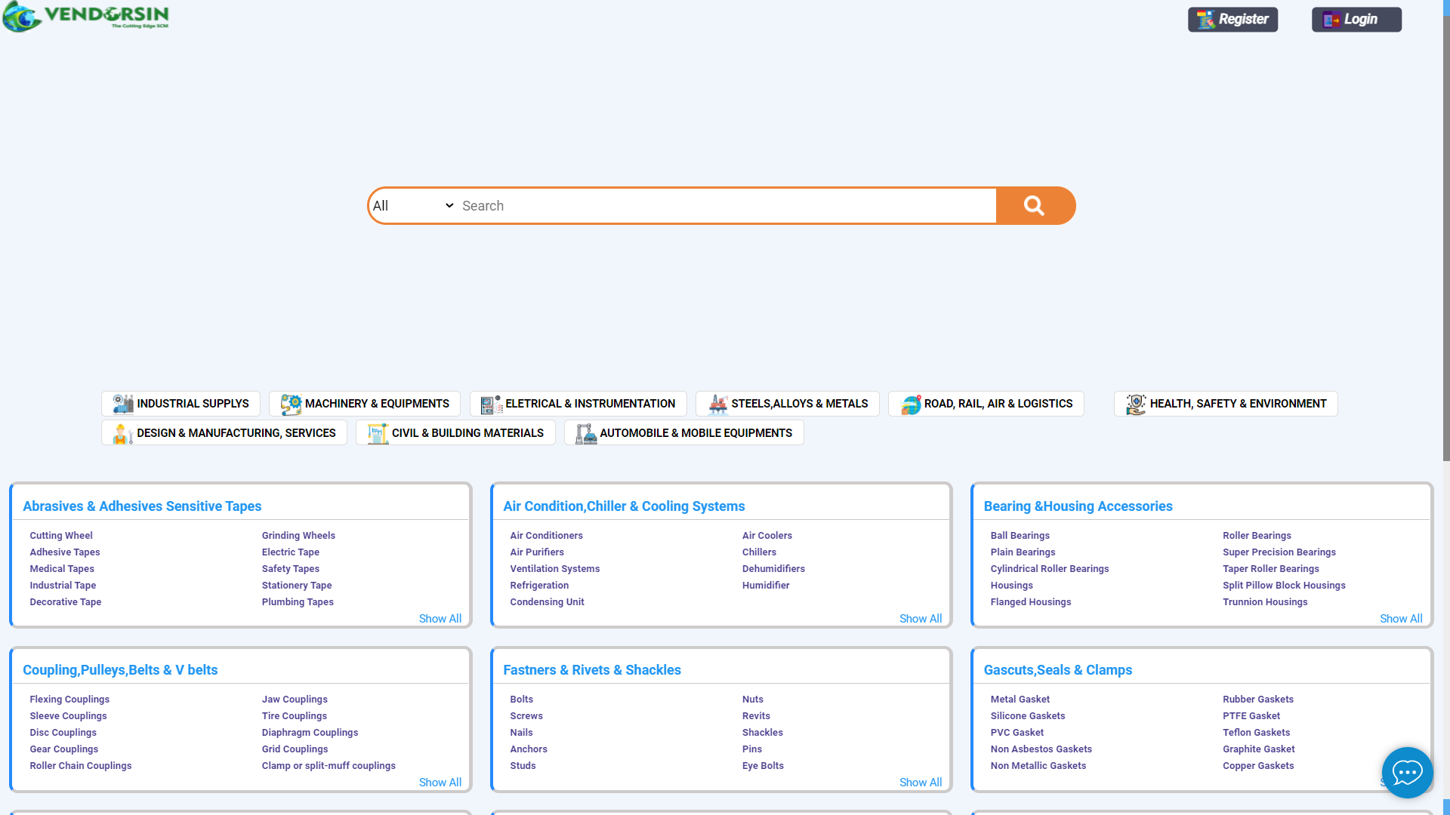
REGISTRATION PROCESS
Click on Register tab

Slide 2
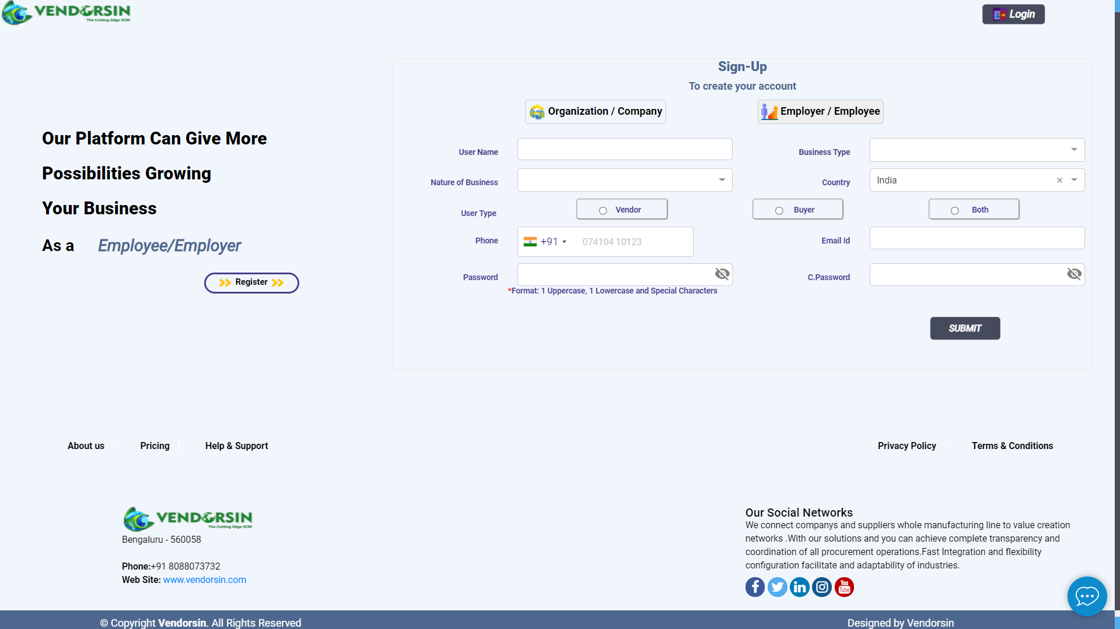
STEP 1 – USER CATEGORY SELECTION
Select registration criteria

Slide 3
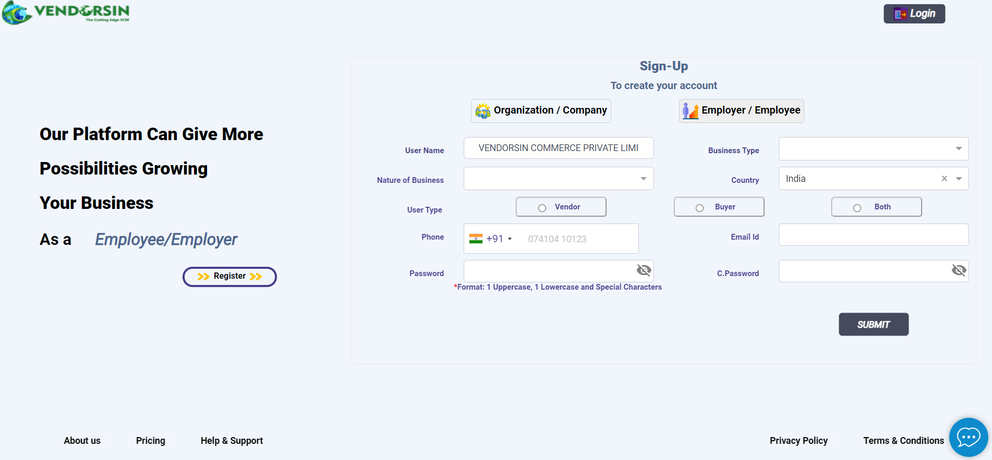
STEP 2 – USER CATEGORY SELECTION
Company name to be provided in user name

Slide 4
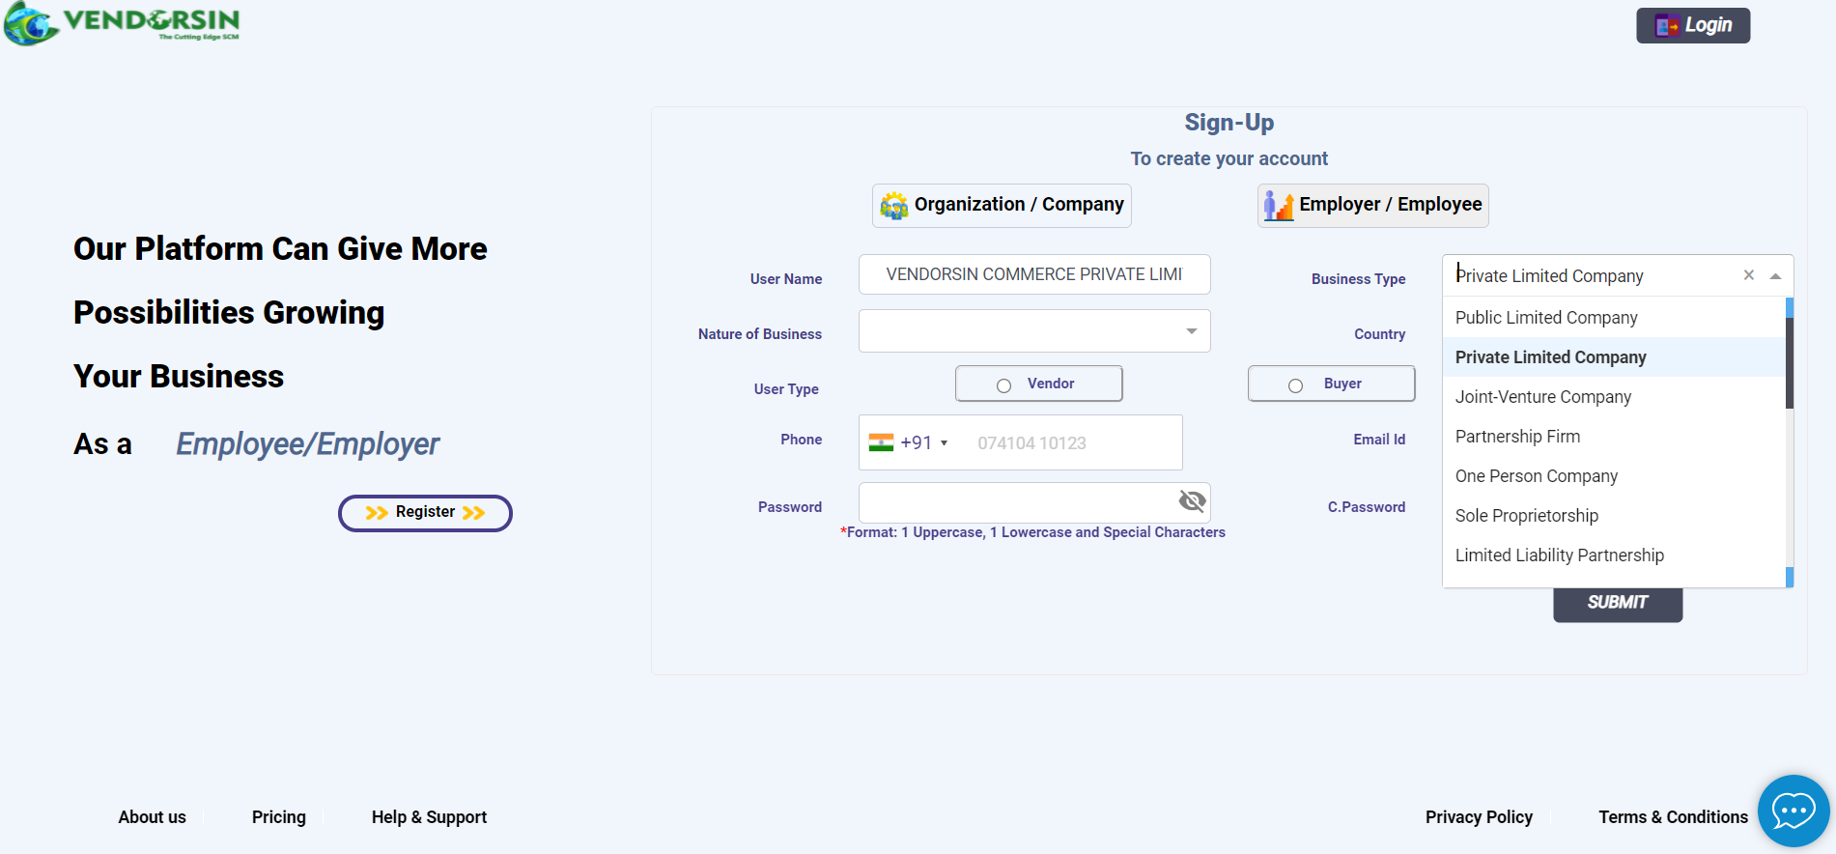
STEP 3 – USER CATEGORY SELECTION
Select business type from drop down

Slide 5
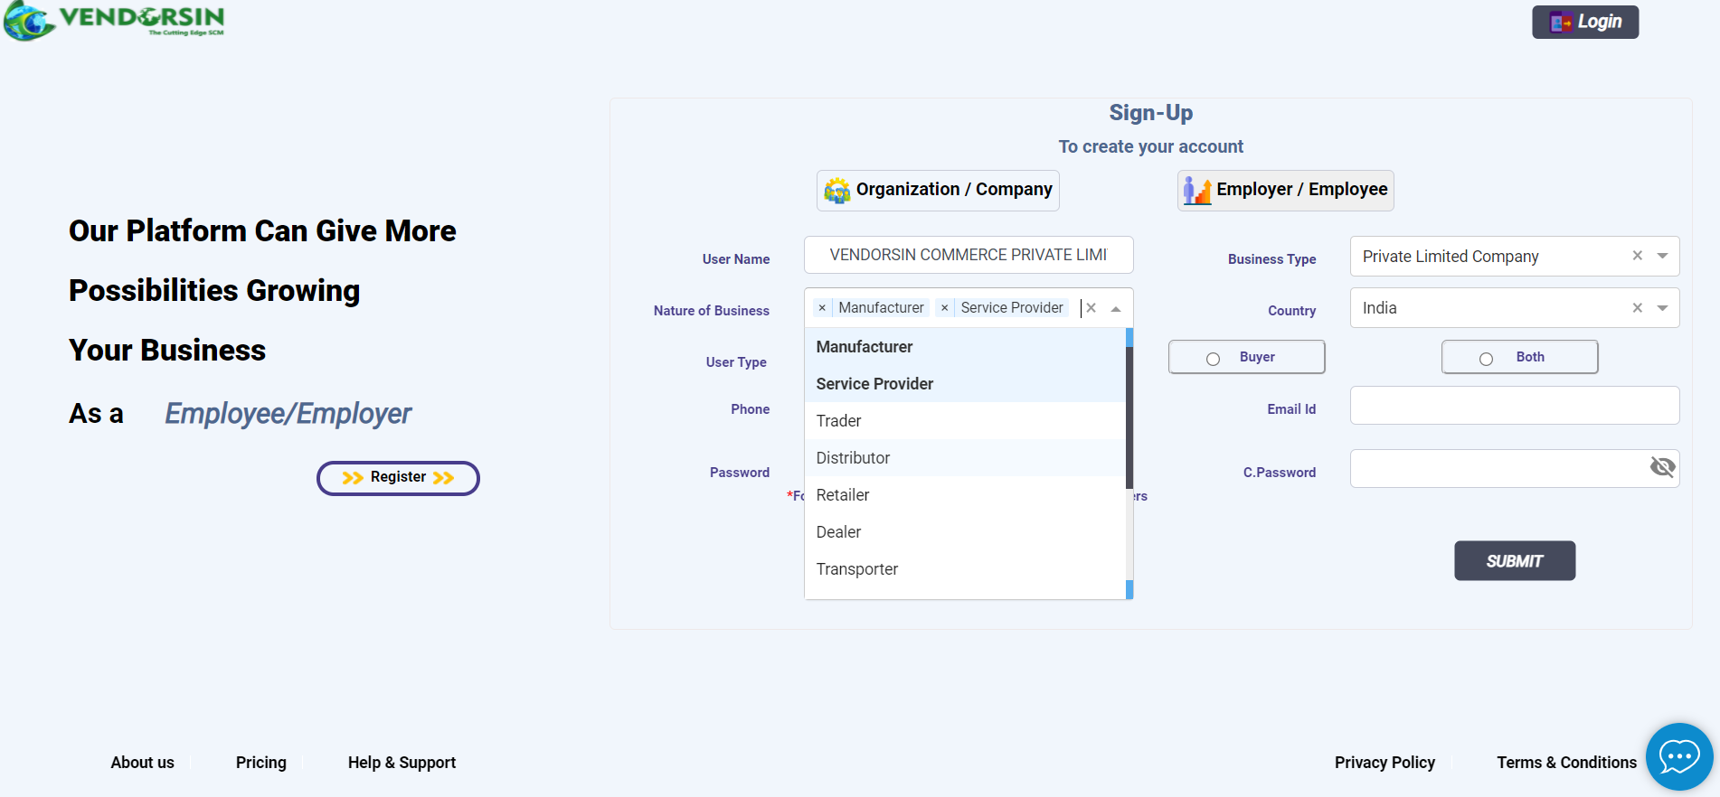
STEP 4 – USER CATEGORY SELECTION
Select business nature from drop down
Multiple selection can be done

Slide 6
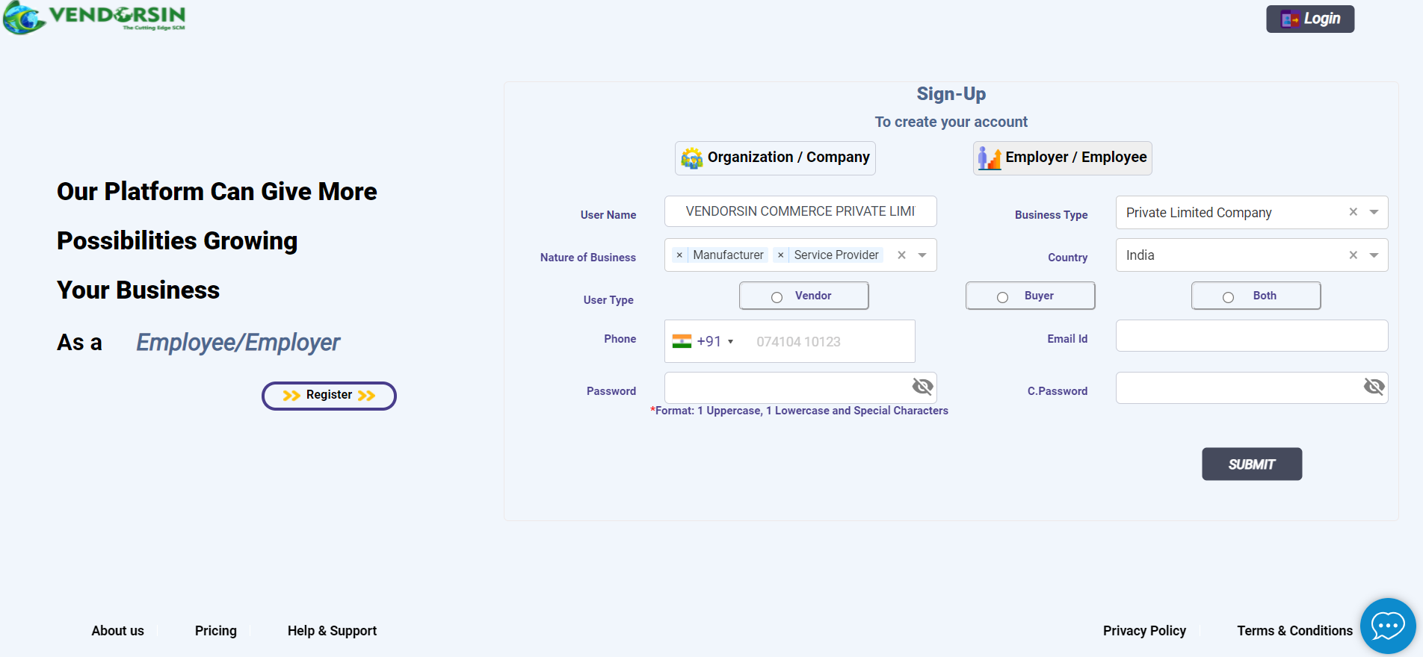
STEP 5 – USER CATEGORY SELECTION
Select user type

Slide 7
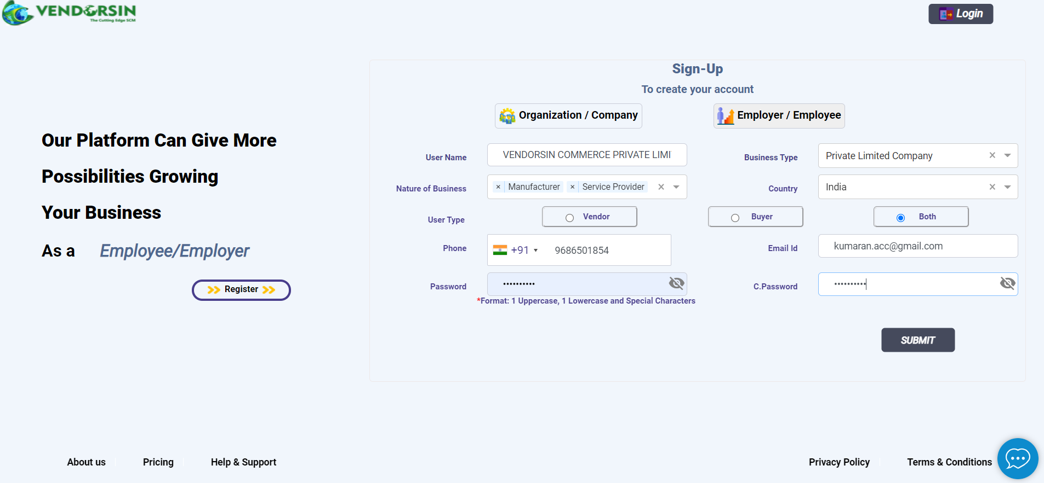
STEP 6 – USER CREDENTIALS REGISTRATION
Provide valid credentials & submit

Slide 8
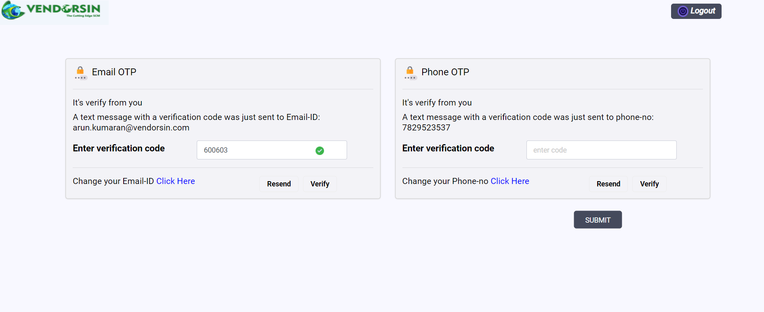

STEP 7 – USER CREDENTIALS REGISTRATION
Enter OTP & verify
Click SUBMIT
YOU ARE SET TO GO

Slide 9
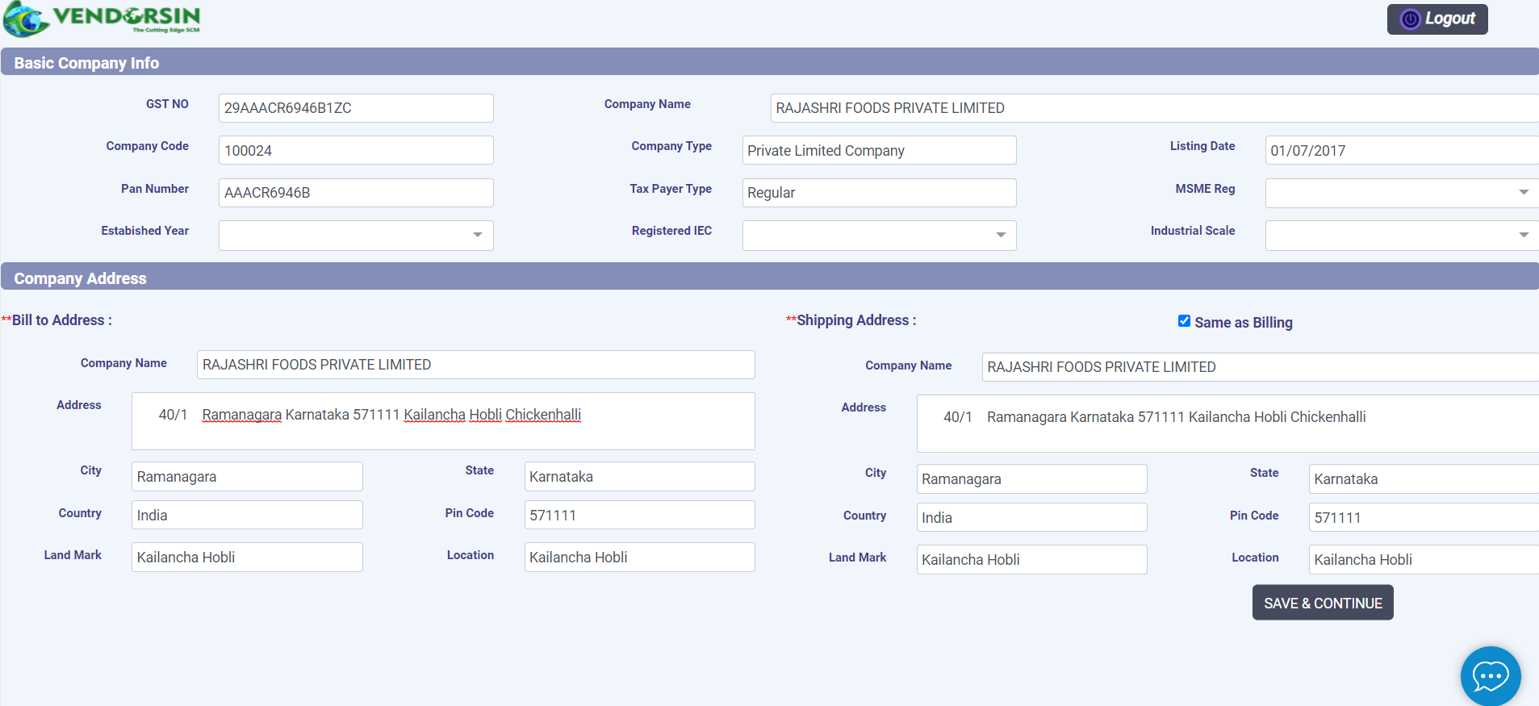
STEP 8 – GSTN SUBMISSION
Enter GSTN details
System will get all details automatically after entering GSTN

Slide 10
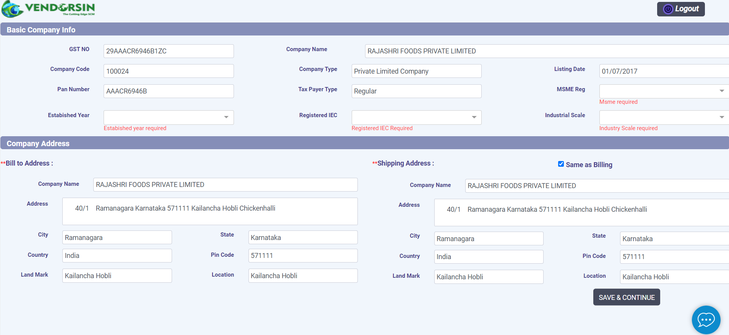
STEP 9 – GSTN SUBMISSION
Select from the drop down

Slide 11
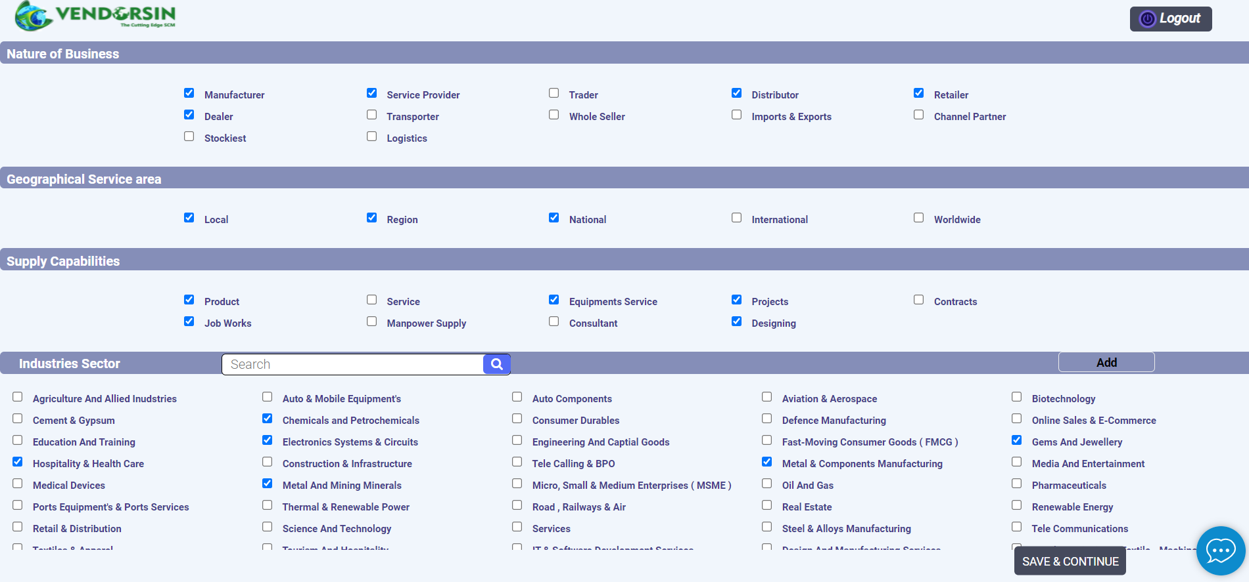
STEP 10 – Company business details
Select applicable details and Submit

Slide 12
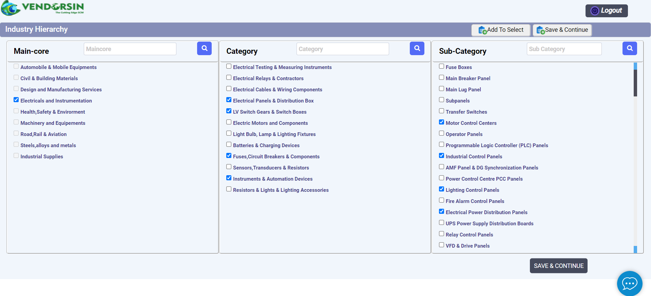
STEP 11 – Select Industry hierarchy
After selection of hierarchy (Multiple selection available)
click Add To Select

Slide 13
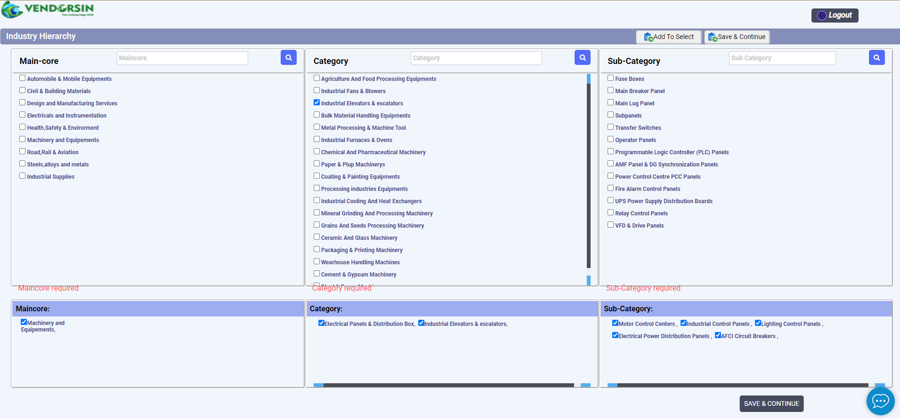

STEP 12 – Select Industry hierarchy
After adding click SAVE&CONTINUE

Slide 14
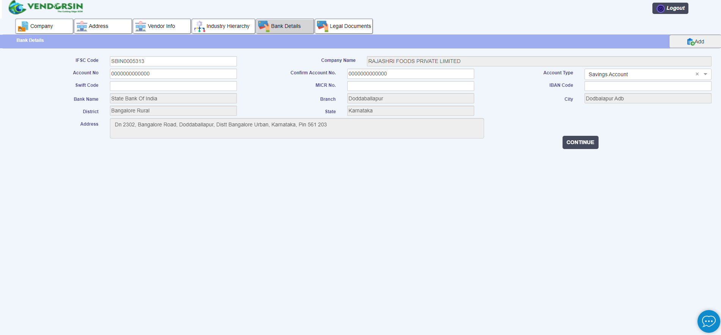
STEP 13 – Bank details Updation
Enter Bank account details
&
Click CONTINUE

Slide 15
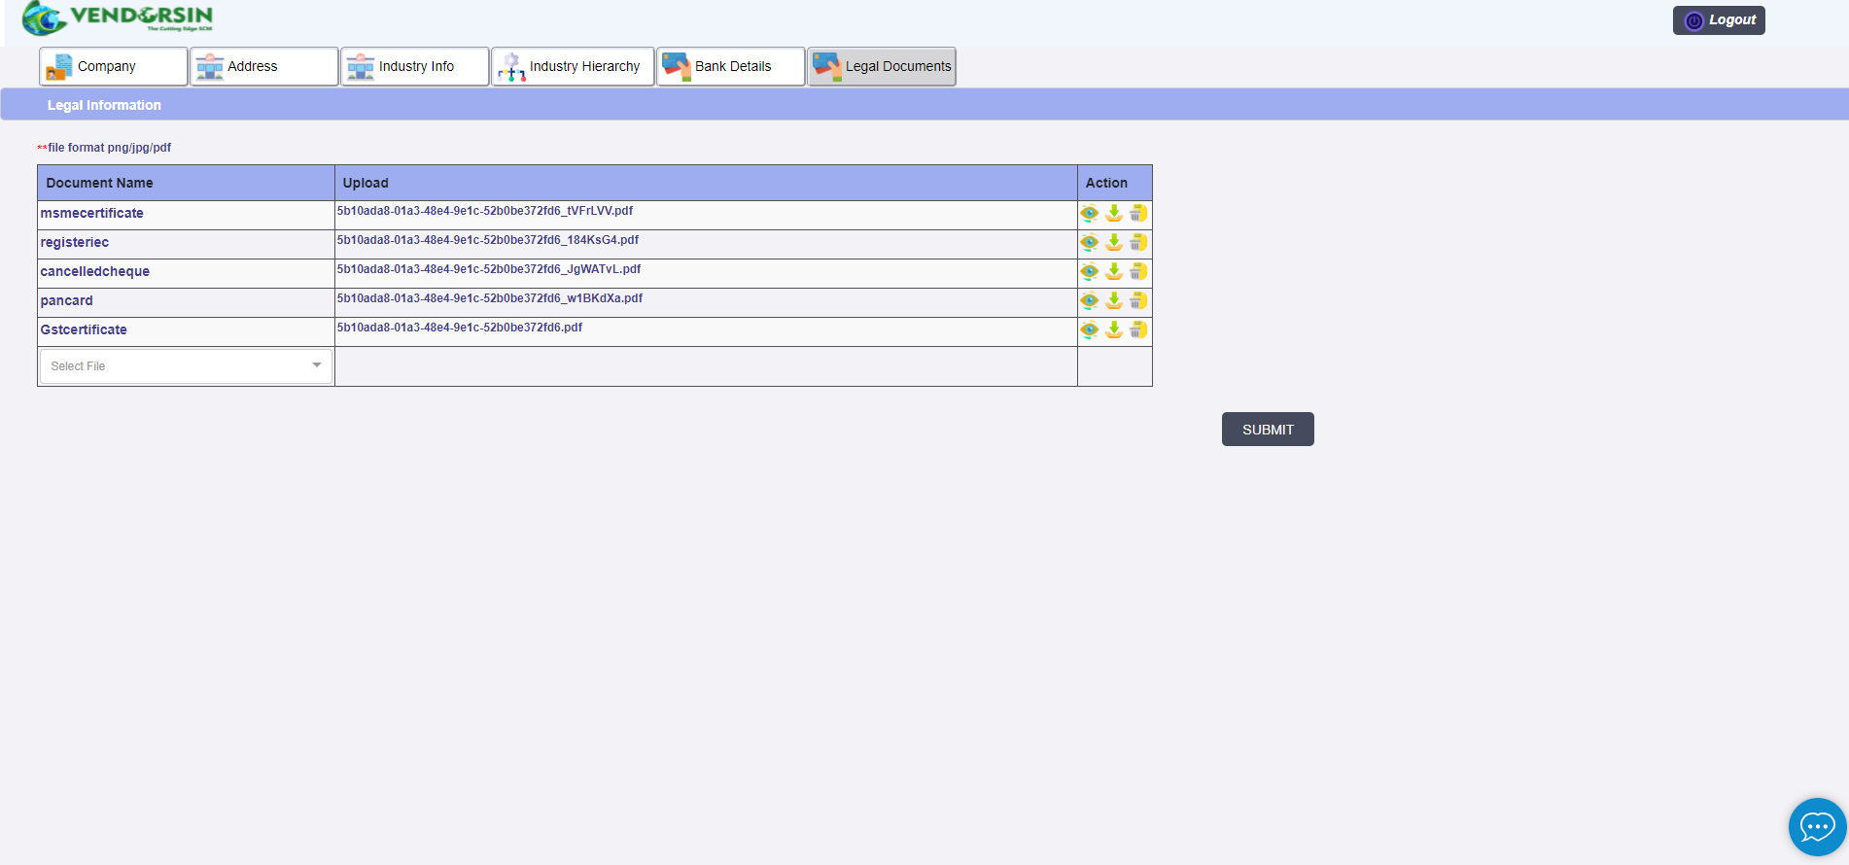
STEP 14 – Vendor Validation
Upload required documents
&
Click SUBMIT

Slide 16
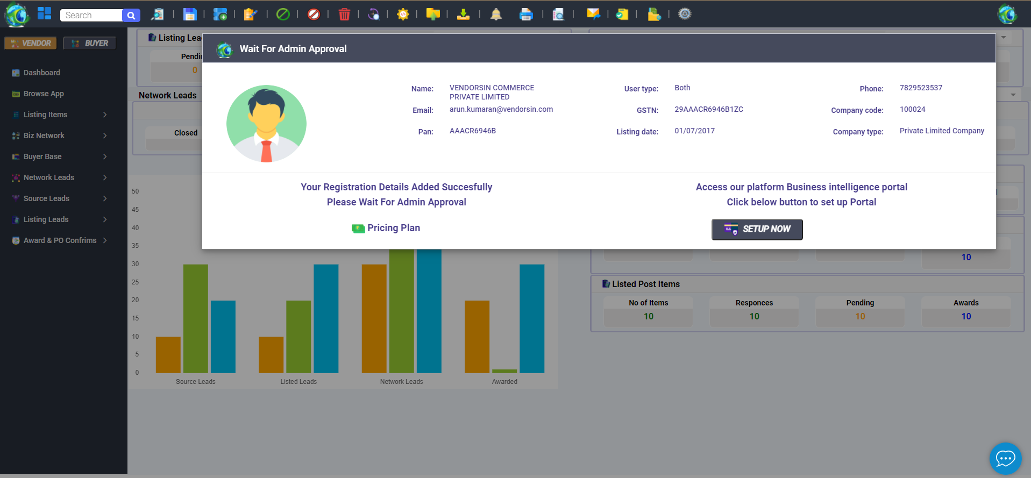
STEP 15 – Vendor Dashboard
ALL DONE
Please wait for Admin approval

Slide 17


Welcome to
VENDORSIN family

